Slide 1


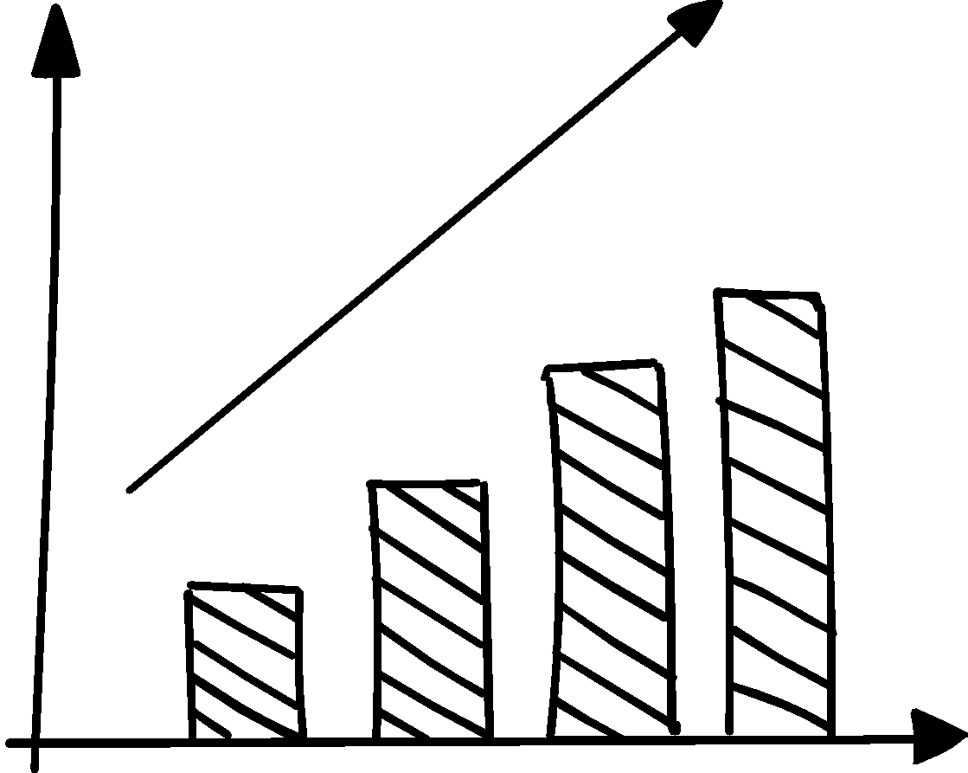
毛孩子宠物领养平台中期进度汇报
2024.4.17 404小组 郝建斌、王靖博、李晟煜

Slide 2

CONTENTS
项目概述
已开发功能展示
技术路线
待开发功能

Slide 3

PART 01
项目概述

Slide 4
需求分析
在当今社会，越来越多的人意识到宠物领养的重要性。然而，传统的宠物领养方式可能存在一些问题，如信息不对称、手续繁琐、匹配困难等。因此，设计一个全面的、用户友好的宠物领养系统变得至关重要。
这个系统的目的是为了促进宠物领养过程的顺利进行，实现宠物和家庭的最佳匹配。通过提供详尽的宠物信息、简化的领养流程、互动交流平台以及领养后的支持和指导，我们希望能够让更多的人选择领养而非购买宠物，从而减少流浪动物的数量，提升社会对待宠物的责任感和意识。此外，这个系统也是一个社会责任的体现。通过确保领养过程符合宠物福利的原则，以及传递正确的宠物领养和护理知识，我们致力于提高整个社会对待宠物的品质和水平，为宠物及其主人带来更美好的生活。
综上所述，设计宠物领养系统旨在创造一个安全、便捷、贴心的平台，为宠物和领养者之间建立起可持续、幸福的关系，同时推动社会的文明进步。

Slide 5
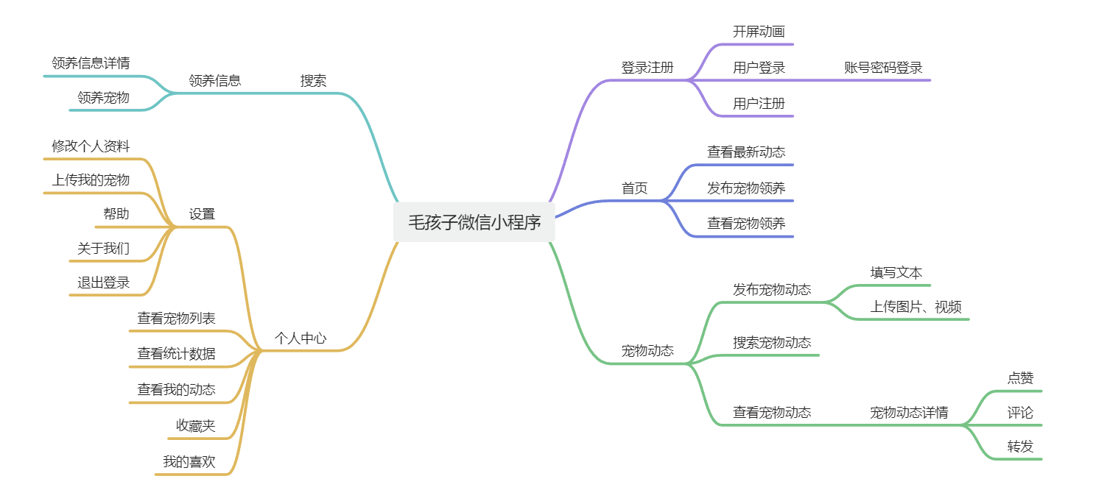
基本功能概述
用户可以分享自己和宠物的日常生活
用户可以为身边的流浪动物发布领养信息
用户可以从领养信息中选择想要领养的宠物
用户可以关注自己感兴趣的博主及其宠物
用户可以查看收藏的宠物动态
用户可以在动态详情页对动态进行评论
用户可以查看自己的浏览历史
用户可以查看自己发布的动态
用户可以上传宠物视频和照片
用户可以浏览照顾宠物的注意事项和教程等
用户可以发布宠物相关的问题
用户可以回答他人提出的问题

Slide 6
PART 02
已开发功能展示

Slide 7
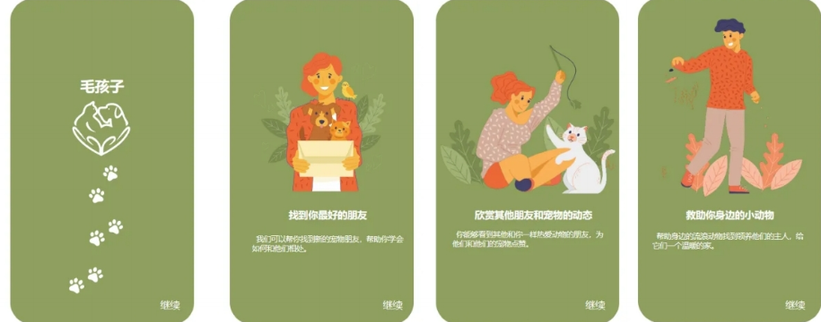
开屏动画
开屏动画展示，用户依次点击进入登陆页面

Slide 8
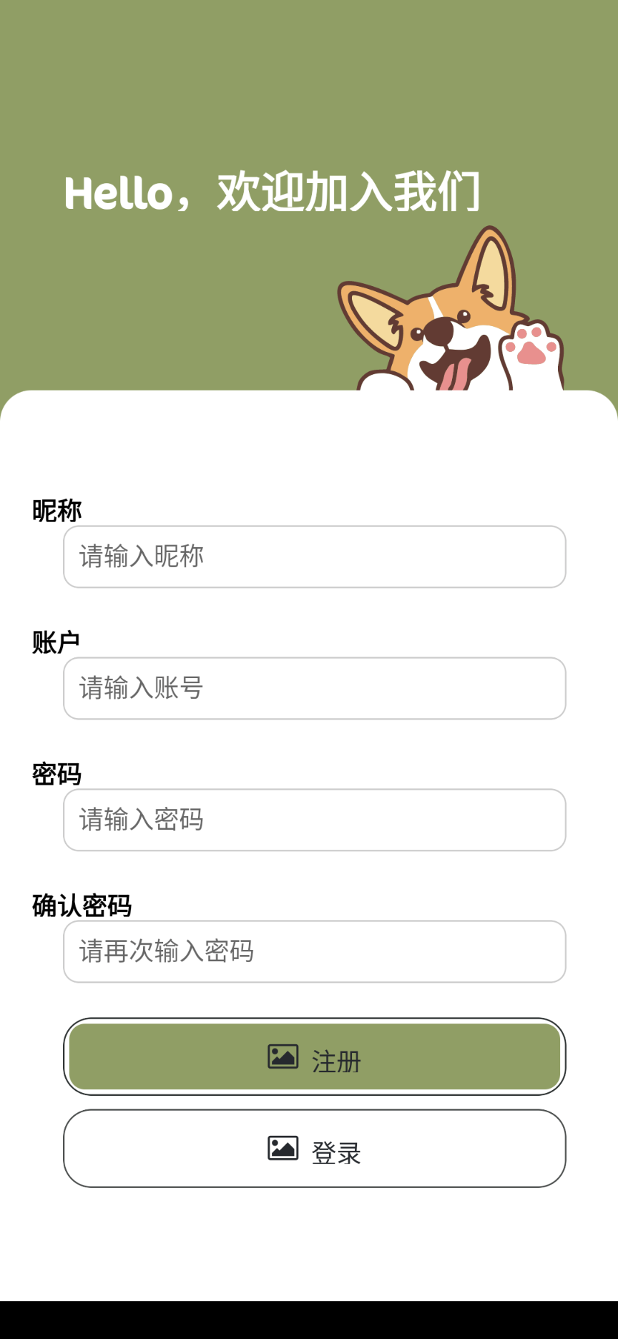
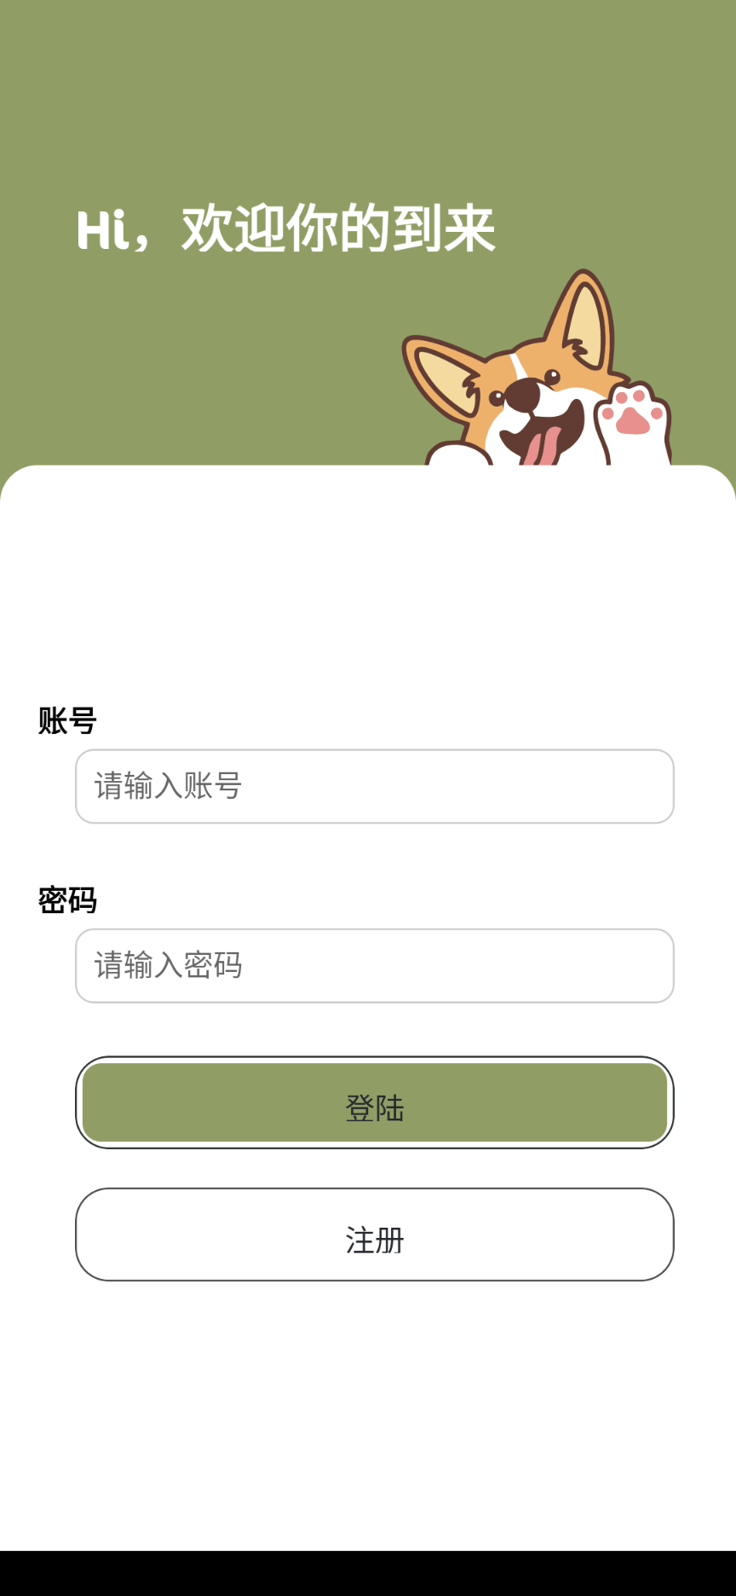
登陆注册界面
如果用户尚未注册可以点击注册前去注册，注册成功后登录，已有帐户则直接登录

Slide 9
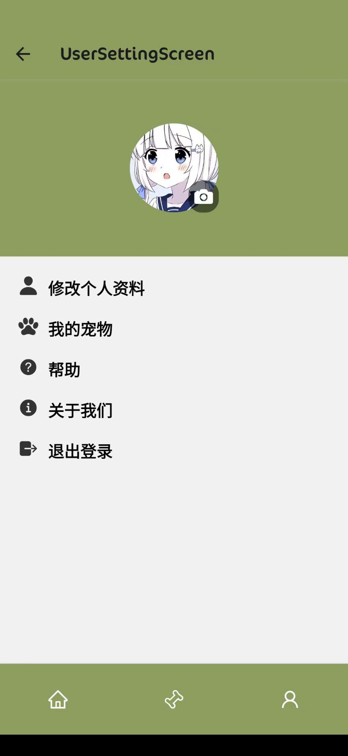

个人中心
用户可以在个人中心界面修改个人资料、查看我的宠物信息/退出登录等操作

Slide 10
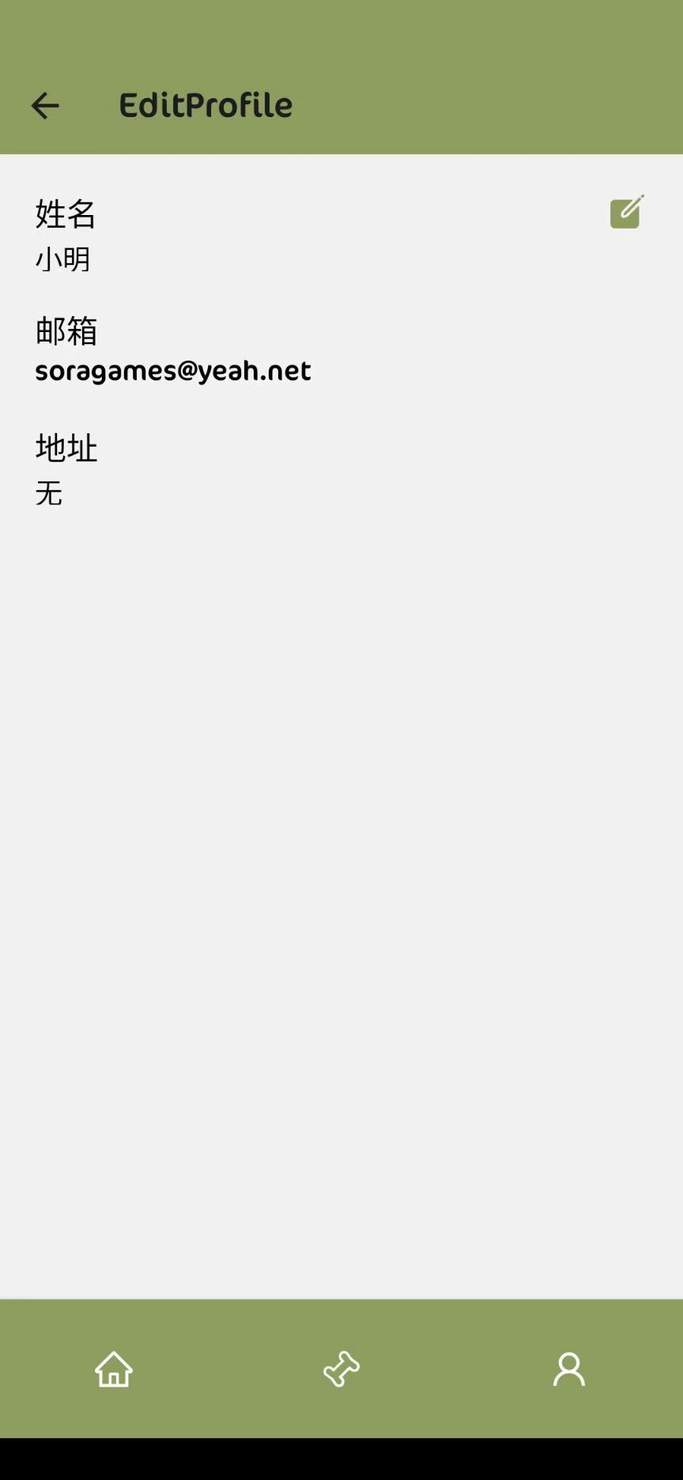
修改个人信息

Slide 11
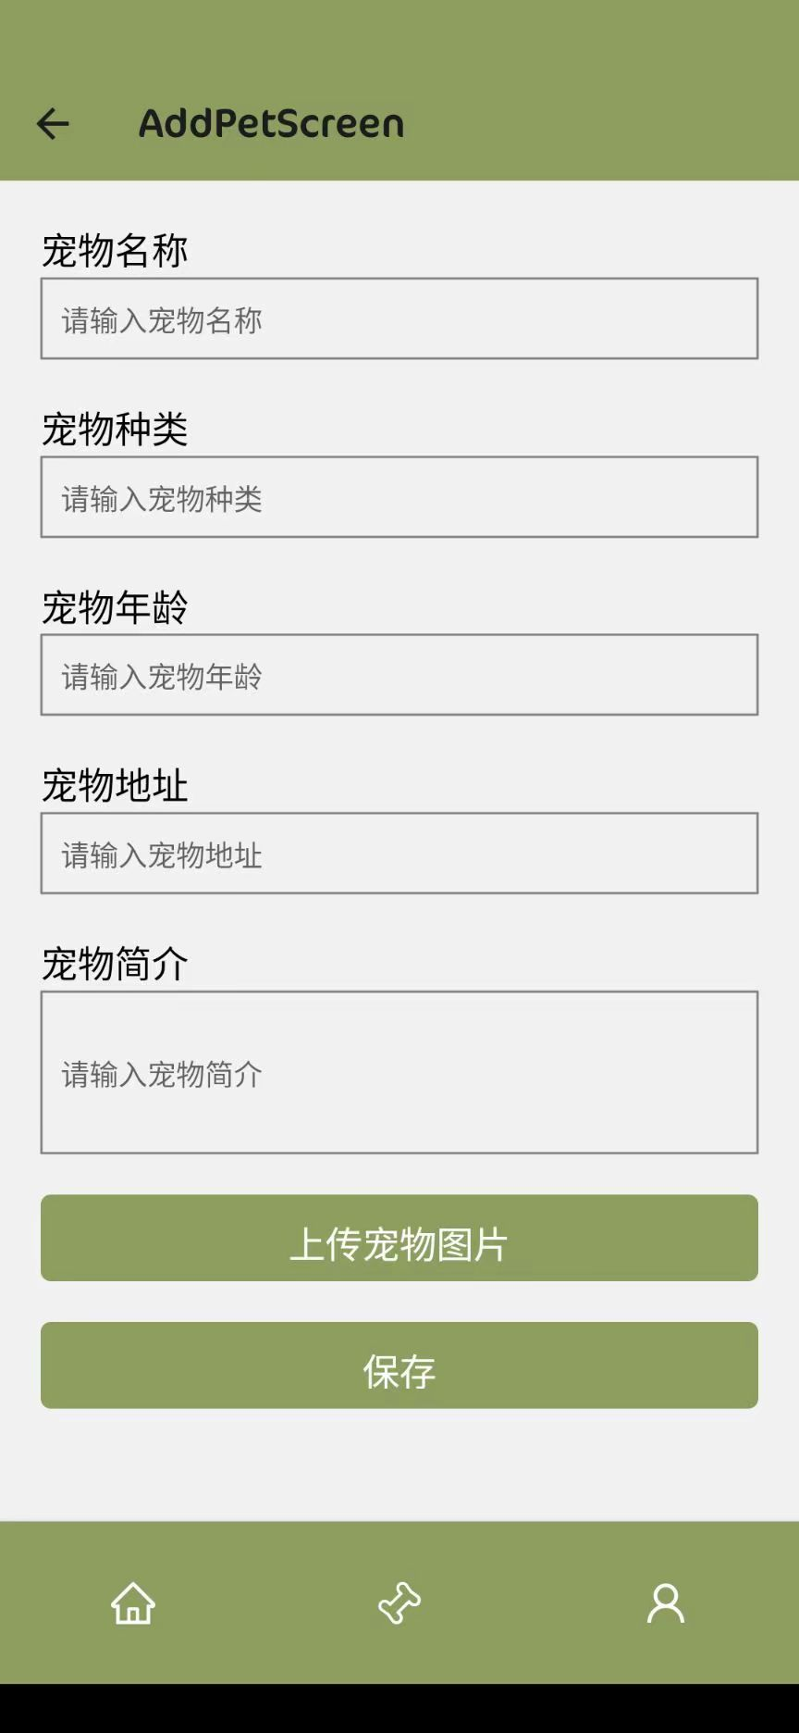
添加宠物信息

Slide 12
PART 03
技术路线

Slide 13
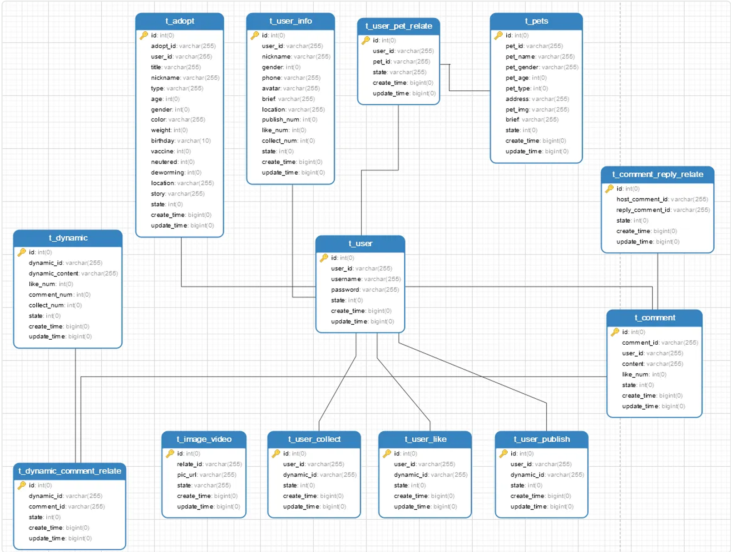
ER图
提供⼀个直观的实体关系图，展现用户、宠物、领养、动态、工具表等主要实体及其相互关系，如用户与宠物的关联、用户与动态的发布、收藏、点赞关系等

Slide 14
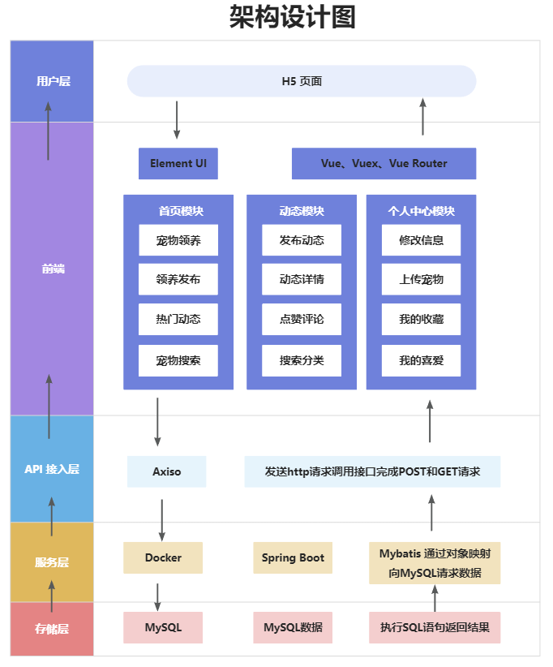


软件架构设计图
THIS TEMPLATE DESIGNED FOR FEI ER SHE JI

Slide 15
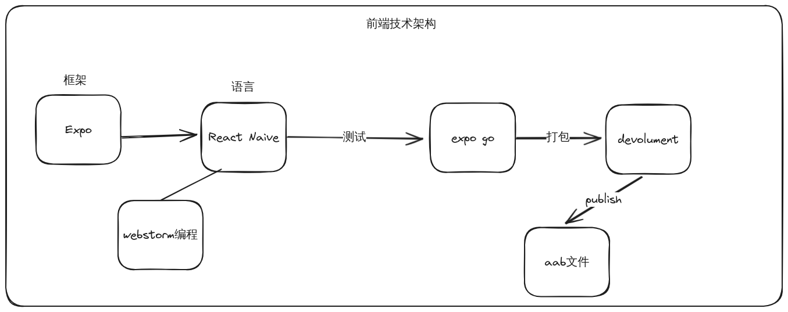
前端技术栈
THIS TEMPLATE DESIGNED FOR FEI ER SHE JI
Expo 是一个基于 React Native 的开发平台,它为构建高质量原生 iOS 和 Android 应用程序提供了一个简单而高效的工作流程。Expo 为开发者提供了一套完整的工具和服务,使应用程序的构建、部署和迭代变得更加轻松。

Slide 16
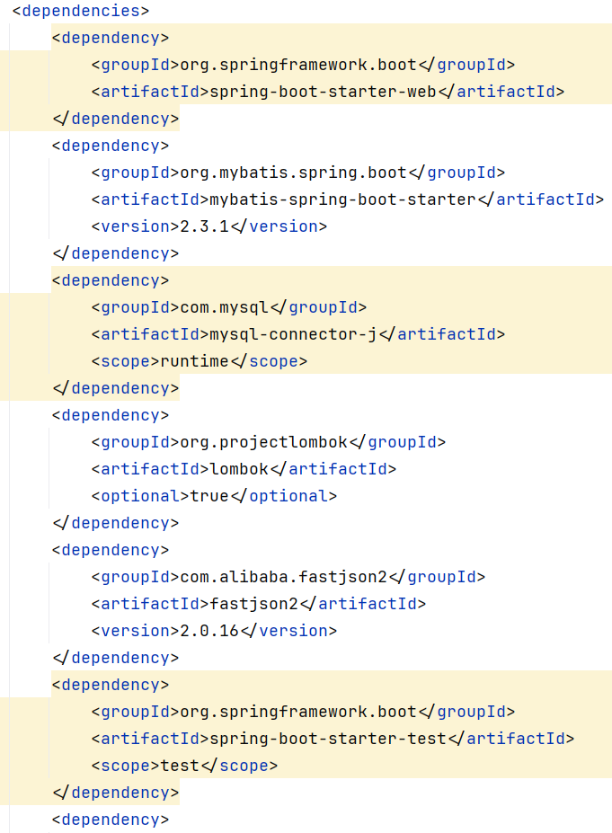
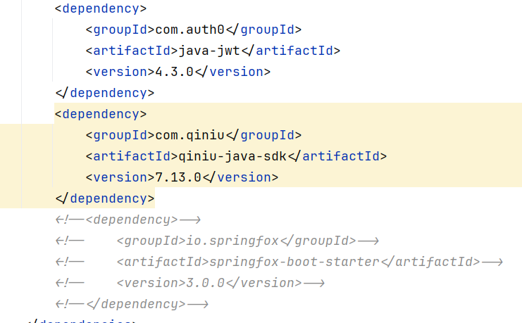
后端技术栈
THIS TEMPLATE DESIGNED FOR FEI ER SHE JI
SpringBoot、Mybatis、MySQL、QiniuSDK、jwt、fastjson、docker、docker-compose

Slide 17
PART 04
待开发功能

Slide 18

待开发功能
首页界面设计
宠物动态
包含最新动态信息的推送，可以点击查看详情，也可以选择上传宠物信息和查看其他宠物信息，选择进行领养
宠物动态页，用户可以查看他人上传的动态，也可以发布自己的动态。支持上传图片/视频等格式。
领养中心界面设计
发布领养
支持用户根据类型和关键词检索宠物领养信息，选择感兴趣的信息查看详情
用户可以发布身边流浪动物的领养信息，需要填写相近的表单，填写发布后，信息出现在首页供用户查看。

Slide 19
THANK YOU
感谢您的观看
2024.4.17

Slide 20
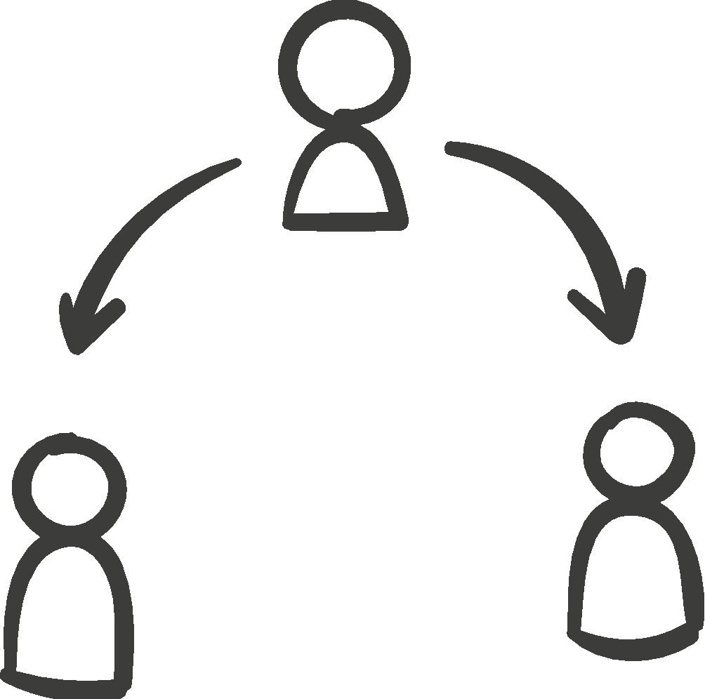
标题文字添加
THIS TEMPLATE DESIGNED FOR FEI ER SHE JI
标题文字添加
The user can demonstrate on a projector or print the presentation and make it into a film to be used in a wider field
标题文字添加
标题文字添加
The user can demonstrate on a projector or print the presentation and make it into a film to be used in a wider field
The user can demonstrate on a projector or print the presentation and make it into a film to be used in a wider field

Slide 21


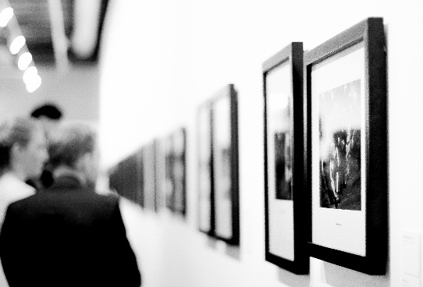
标题文字添加
THIS TEMPLATE DESIGNED FOR FEI ER SHE JI
标题文字添加
标题文字添加
The user can demonstrate on a projector or print the presentation and make it into a film to be used in a wider field
The user can demonstrate on a projector or print the presentation and make it into a film to be used in a wider field

Slide 22



标题文字添加
THIS TEMPLATE DESIGNED FOR FEI ER SHE JI
标题文字添加
标题文字添加
标题文字添加
The user can demonstrate on a projector or print the presentation and make it into a film to be used in a wider field
The user can demonstrate on a projector or print the presentation and make it into a film to be used in a wider field
The user can demonstrate on a projector or print the presentation and make it into a film to be used in a wider field

Slide 23
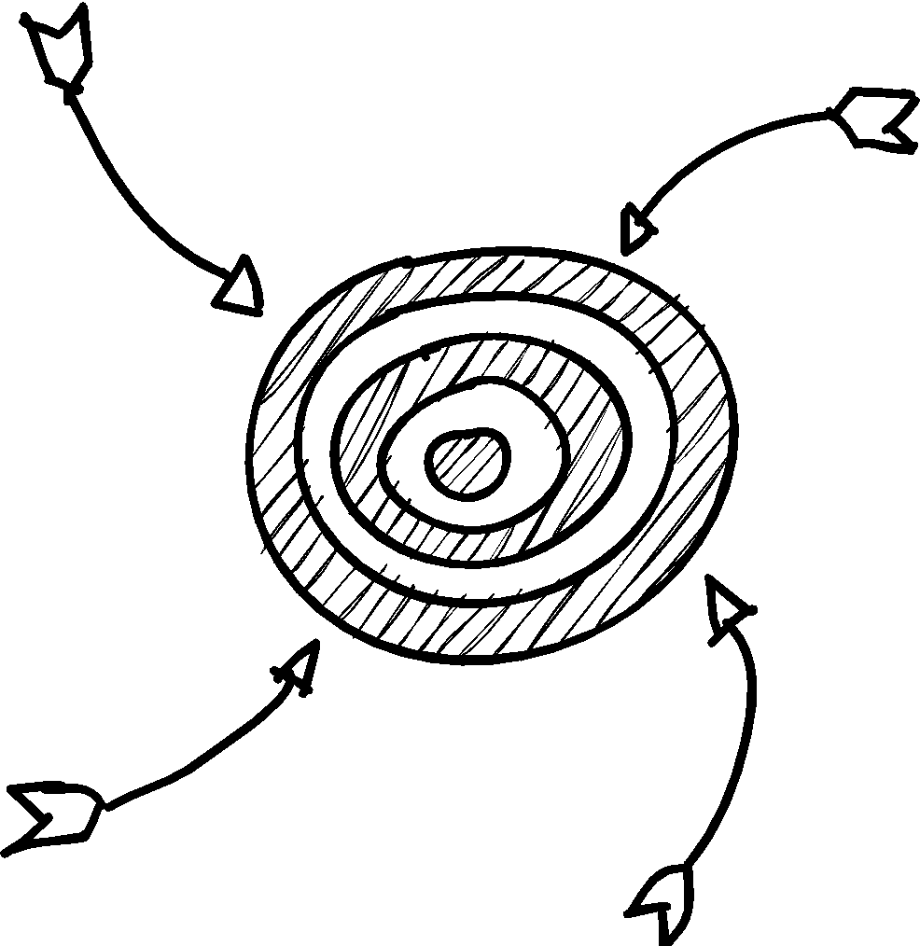
标题文字添加
THIS TEMPLATE DESIGNED FOR FEI ER SHE JI
标题文字添加
标题文字添加
The user can demonstrate on a projector or print the presentation and make it into a film to be used in a wider field
The user can demonstrate on a projector or print the presentation and make it into a film to be used in a wider field
标题文字添加
标题文字添加
The user can demonstrate on a projector or print the presentation and make it into a film to be used in a wider field
The user can demonstrate on a projector or print the presentation and make it into a film to be used in a wider field

Slide 24

标题文字添加
THIS TEMPLATE DESIGNED FOR FEI ER SHE JI
标题文字添加
The user can demonstrate on a projector or print the presentation and make it into a film to be used in a wider field
标题文字添加
标题文字添加
The user can demonstrate on a projector or print the presentation and make it into a film to be used in a wider field
The user can demonstrate on a projector or print the presentation and make it into a film to be used in a wider field

Slide 25

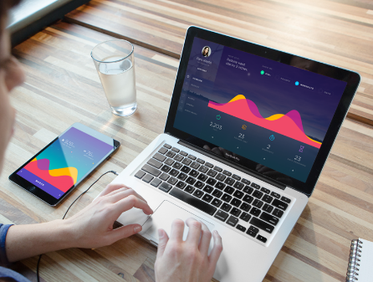


标题文字添加
THIS TEMPLATE DESIGNED FOR FEI ER SHE JI
标题文字添加
标题文字添加
The user can demonstrate on a projector or print the presentation and make it into a film to be used in a wider field
The user can demonstrate on a projector or print the presentation and make it into a film to be used in a wider field
标题文字添加
标题文字添加
The user can demonstrate on a projector or print the presentation and make it into a film to be used in a wider field
The user can demonstrate on a projector or print the presentation and make it into a film to be used in a wider field

Slide 26

标题文字添加
THIS TEMPLATE DESIGNED FOR FEI ER SHE JI
标题文字添加
The user can demonstrate on a projector or print the presentation and make it into a film to be used in a wider fieldThe user can demonstrate on a projector or print the presentation and make it into a film to be used in a wider fieldThe user can demonstrate on a projector or print the presentation and make it into a film to be used in a wider fieldThe user can demonstrate on a projector or print the presentation and make it into a film to be used in a wider field

Slide 27


标题文字添加
THIS TEMPLATE DESIGNED FOR FEI ER SHE JI
标题文字添加
标题文字添加
The user can demonstrate on a projector or print the presentation and make it into a film to be used in a wider field
The user can demonstrate on a projector or print the presentation and make it into a film to be used in a wider field
标题文字添加
标题文字添加
The user can demonstrate on a projector or print the presentation and make it into a film to be used in a wider field
The user can demonstrate on a projector or print the presentation and make it into a film to be used in a wider field

Slide 28

标题文字添加
THIS TEMPLATE DESIGNED FOR FEI ER SHE JI
文字添加
文字添加
文字添加
The user can demonstrate on a projector or print the presentation and make it into a film to be used in a wider field
The user can demonstrate on a projector or print the presentation and make it into a film to be used in a wider field
The user can demonstrate on a projector or print the presentation and make it into a film to be used in a wider field

Slide 29


标题文字添加
THIS TEMPLATE DESIGNED FOR FEI ER SHE JI
标题文字添加
标题文字添加
The user can demonstrate on a projector or print the presentation and make it into a film to be used in a wider field
The user can demonstrate on a projector or print the presentation and make it into a film to be used in a wider field
标题文字添加
标题文字添加
The user can demonstrate on a projector or print the presentation and make it into a film to be used in a wider field
The user can demonstrate on a projector or print the presentation and make it into a film to be used in a wider field

Slide 30


标题文字添加
THIS TEMPLATE DESIGNED FOR FEI ER SHE JI
标题文字添加
The user can demonstrate on a projector or print the presentation and make it into a film to be used in a wider field
标题文字添加
The user can demonstrate on a projector or print the presentation and make it into a film to be used in a wider field
标题文字添加
The user can demonstrate on a projector or print the presentation and make it into a film to be used in a wider field
标题文字添加
The user can demonstrate on a projector or print the presentation and make it into a film to be used in a wider field

Slide 31

标题文字添加
THIS TEMPLATE DESIGNED FOR FEI ER SHE JI
标题文字添加
The user can demonstrate on a projector or print the presentation and make it into a film to be used in a wider field
标题文字添加
The user can demonstrate on a projector or print the presentation and make it into a film to be used in a wider field
标题文字添加
The user can demonstrate on a projector or print the presentation and make it into a film to be used in a wider field

Slide 32
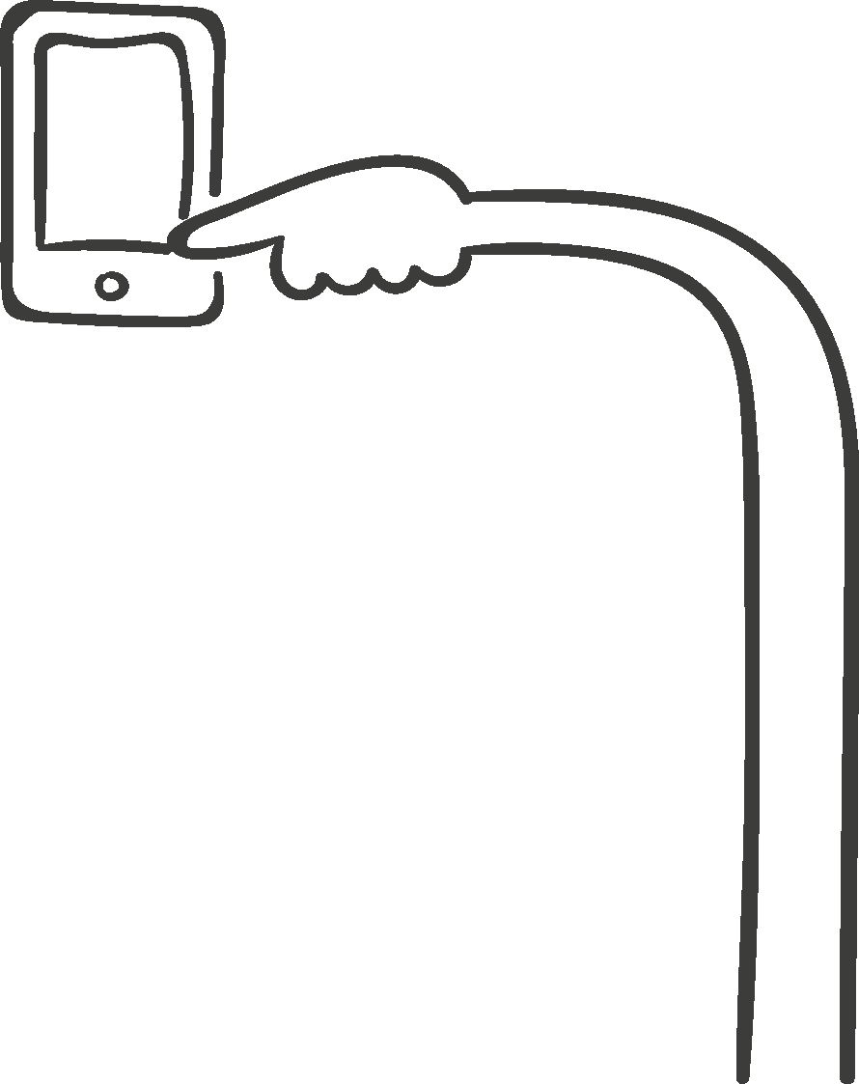
标题文字添加
THIS TEMPLATE DESIGNED FOR FEI ER SHE JI
标题文字添加
The user can demonstrate on a projector or print the presentation and make it into a film to be used in a wider field
标题文字添加
The user can demonstrate on a projector or print the presentation and make it into a film to be used in a wider field
标题文字添加
The user can demonstrate on a projector or print the presentation and make it into a film to be used in a wider field

Slide 33
基本功能展示
标题文字添加
The user can demonstrate on a projector or print the presentation and make it into a film to be used in a wider field
标题文字添加
The user can demonstrate on a projector or print the presentation and make it into a film to be used in a wider field
标题文字添加
The user can demonstrate on a projector or print the presentation and make it into a film to be used in a wider field

Slide 34

标题文字添加
THIS TEMPLATE DESIGNED FOR FEI ER SHE JI
1
2
3
标题文字添加
标题文字添加
标题文字添加
The user can demonstrate on a projector or print the presentation and make it into a film to be used in a wider field
The user can demonstrate on a projector or print the presentation and make it into a film to be used in a wider field
The user can demonstrate on a projector or print the presentation and make it into a film to be used in a wider field

Slide 35
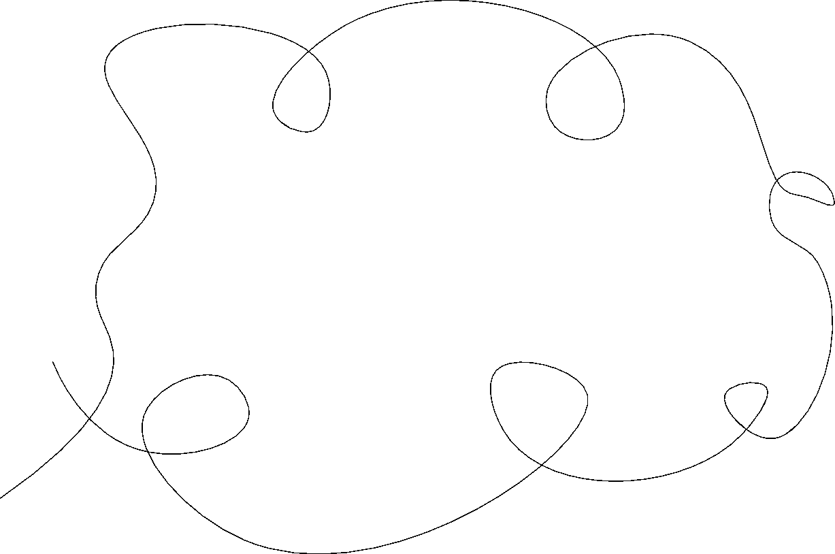
标题文字添加此处
The user can demonstrate on a projector or computer, or print the presentation and make it into a film to be used in a wider field

Slide 36
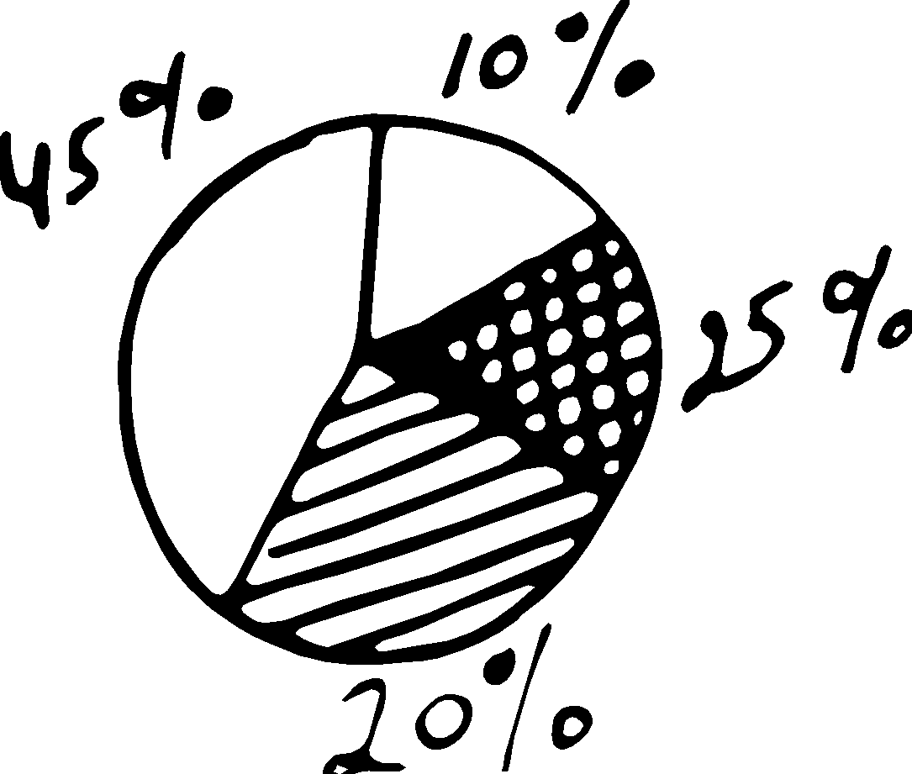
标题文字添加
THIS TEMPLATE DESIGNED FOR FEI ER SHE JI
标题文字添加
标题文字添加
The user can demonstrate on a projector or print the presentation and make it into a film to be used in a wider field
The user can demonstrate on a projector or print the presentation and make it into a film to be used in a wider field
标题文字添加
标题文字添加
The user can demonstrate on a projector or print the presentation and make it into a film to be used in a wider field
The user can demonstrate on a projector or print the presentation and make it into a film to be used in a wider field

Slide 37
标题文字添加
THIS TEMPLATE DESIGNED FOR FEI ER SHE JI
文字添加
文字添加
文字添加
文字添加
The user can demonstrate on a projector or print the presentation and make it into a film to be used in a wider field
The user can demonstrate on a projector or print the presentation and make it into a film to be used in a wider field
The user can demonstrate on a projector or print the presentation and make it into a film to be used in a wider field
The user can demonstrate on a projector or print the presentation and make it into a film to be used in a wider field

Slide 38


标题文字添加
THIS TEMPLATE DESIGNED FOR FEI ER SHE JI
标题文字添加
The user can demonstrate on a projector or print the presentation and make it into a film to be used in a wider fieldThe user can demonstrate on a projector or print the presentation and make it into a film to be used in a wider field
标题文字添加
The user can demonstrate on a projector or print the presentation and make it into a film to be used in a wider fieldThe user can demonstrate on a projector or print the presentation and make it into a film to be used in a wider field

